Slide 1
Keyboard shortcuts

Slide 2
Global
? Show shortcuts
p Projects and teams
s Search
g h Go to Home
g c Go to Code
g w Go to Work
g b Go to Build
g t Go to Test
Code
r Select repository
e Open explorer
c Open changesets
v Open shelvesets
Explorer
1 Open contents
2 Open history
Work
z Toggle full screen mode
q Go to Queries
b Go to Board
l Go to Backlog
i Go to Current Iteration
t Go to Task board
Backlogs
j Next item
k Previous item
+j Move item down
+k Move item up
+ Move item to top
m b Move item to Backlog
m i Move item to current iteration
m n Move item to next iteration
a Assign to
 Create child
n Open New Item panel
f Filter by text
Test
n Open Test plan
m Open Shared Parameters
r Open Runs
h Open Machines
Test Plan
1 Open Tests
2 Open Charts
e Execute tests
t p Pass selected tests
t f Fail selected tests
t n Mark selected tests as NA
t b Mark selected tests as Blocked
t r Reset tests to Active
v g View grid
Queries
j Next item
k Previous item
z Toggle full screen mode
c q New query
Work item
z Toggle full screen mode
q Open Queries
b Open Board
l Open Backlog
i Open Current Iteration
t Open Task board
Test
n Open Test plan
m Open Shared Parameters
r Open Runs
h Open Machines
Notes:
Only works when in team project context.

Slide 3
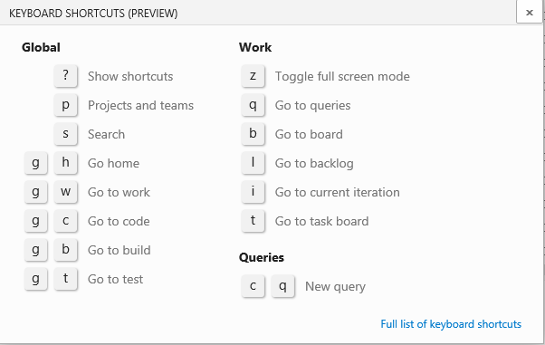
Global
Global
? Show shortcuts
p Projects and teams
s Search
g h Go to home
g c Go to code
g w Go to work
g b Go to build
g t Go to test

Slide 4
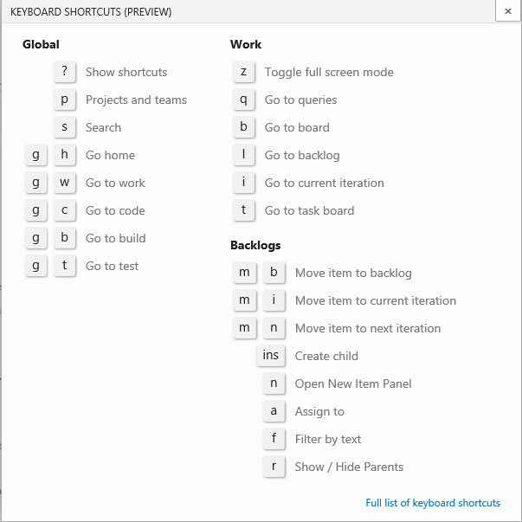
Work
Backlogs
j Next item
k Previous item
+j Move item down
+k Move item up
+ Move item to top
m b Move item to backlog
m i Move item to current iteration
m n Move item to next iteration
a Assign to
 Create child
n Open new item panel
f Filter by text
Work
l Open backlog
b Open board
i Open current iteration
t Open task board
q Open queries
z Toggle full screen mode
Queries
j Next item
k Previous item
z Toggle full screen mode
c q New query
Work item
z Toggle full screen mode
q Open Queries
b Open Board
l Open Backlog
i Open Current Iteration
t Open Task board
Test
n Open test plan
m Open shared parameters
r Open runs
h Open machines

Slide 5
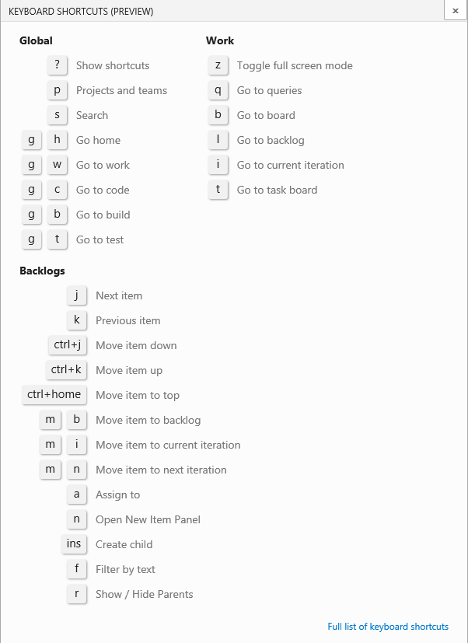
Work
l Open backlog
b Open board
i Open current iteration
t Open task board
q Open queries
z Toggle full screen mode
Backlogs
m b Move item to backlog
m i Move item to current iteration
m n Move item to next iteration
 Create child
a Assign to
n Open new item panel
f Filter by text
r Show/hide parents
1. Open backlog
2. Open board
3. Open current iteration
4. Open task board
5. Open queries
6. Toggle full screen mode
Queries
cq New query
j Next item
k Previous item
+ j Move item down
+ k Move item up
+ Move item to top
Notes:
Needs to be on a selected item:
Create child – needs to be on a selected item

Slide 6
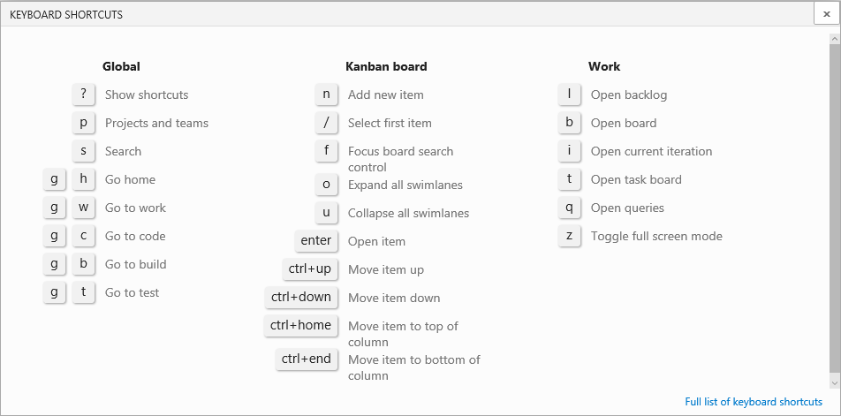

Slide 7
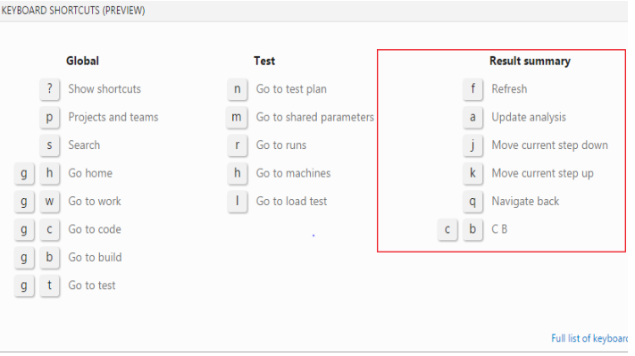
Test
Parameters
1 View parameter set grid
2 View parameter WIT form
c s Add parameter set
v t Toggle test cases pane
c t Add test from test cases pane
Result summary
f Refresh
a Update analysis
j Move current step down
k Move current step up
q Navigate back
c b Create bug
Test
n Open test plan
m Open shared parameters
r Open runs
h Open machines
l Open load test
Test Plan
1 Open tests
2 Open charts
e Execute tests
t p Pass selected tests
t f Fail selected tests
t n Mark selected tests as NA
t b Mark selected tests as blocked
t r Reset tests to active
v g View grid

Slide 8
Navigate within the web portal
Navigate within lists
 (Tab key) Move focus
→↑↓← Move focus up/down, left/right
+ Move focus to top of list
+ Move focus to bottom of list
+↑ Move item up within list
+↓ Move item down within list
+↑/↓ Highlight consecutive items
- (Menu key) Open context menu
 Dismiss context menu
→↑↓← Move focus within context menu
 (Enter key) Choose context menu item
Navigate
++a Move focus to admin link
++h Move focus to help link
++s Move focus to search box
++↑ Move focus to previous section
++↓ Move focus to next section
-
→↑↓←
→↑↓←
m b Move item to Backlog
m i Move item to current iteration
m n Move item to next iteration
a Assign to
 Create child
n Open New Item panel
f Filter by text

Slide 9
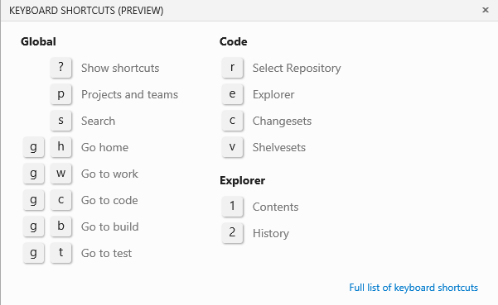
Code
r Select Repository
e Open Explorer
c Open Changesets
v Open Shelvesets
Explorer
1 Open Contents
2 Open History

Slide 10
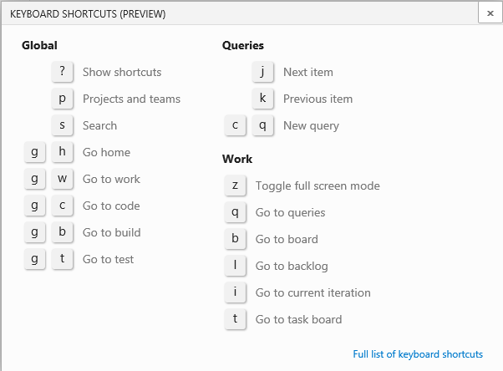
Queries
j Next item
k Previous item
c q New query
Work
b Open Board
i Open Current Iteration
l Open Backlog
q Open Queries
t Open Task board
z Toggle full screen mode

Slide 11
Global
? Show shortcuts
p Projects and teams
s Search
g h Go to Home
g c Go to Code
g w Go to Work
g b Go to Build
g t Go to Test
Test
n Go to Test plan
m Go to shared Parameters
r Go to Runs
h Go to Machines
Test Plan
1 Go to Tests
2 Go to Charts
e r Bulk reset tests to Active
t p Bulk mark tests as Pass
t f Bulk mark tests as Fail
t n Bulk mark tests as PNAass
t b Bulk mark tests as Blocked
o t Open test case with WIT
o c Column options
v g View grid
Work
z Toggle full screen mode
q Go to Queries
b Go to Board
l Go to Backlog
i Go to current Iteration
t Go to Task board
Queries
cq New Query
Work
Toggle full screen mode
↑ Go to Queries
b Go to Board
l Go to Backlog
i Go to current Iteration
t Go to Task board
Queries
cq New Query

⌘→

Slide 12
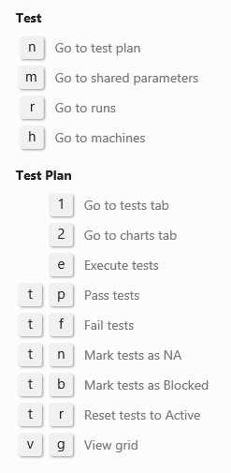
Test
n Open Test plan
m Open Shared Parameters
r Open Runs
h Open Machines
Test Plan
1 Open Tests
2 Open Charts
e Execute tests
t p Pass selected tests
t f Fail selected tests
t n Mark selected tests as NA
t b Mark selected tests as Blocked
t r Reset tests to Active
v g View grid

Slide 13
Team Explorer
Navigate
 Refresh
+0a Open web portal
+0b Open Build
+0c Open Connect
+0d Open Documents
+0e Open Branches (Git)
+0g Open Changes (Git)
+0h Open Home
+0m Open My Work (TFVC)
+0p Open Pending Changes (TFVC)
+0r Open Reports
+0s Open Settings
+0w Open Work Items
+0y Open Sync (Git)
+' Move focus to search box
+0 Move focus to top of page
+1...9 Move focus to visible section [1 – 9]
+↓↑ Move focus to next/previous section
Context menu
↓ Open a context menu
 Dismiss a context menu
→↑↓← Move focus up/down, left/right
 (Enter key) Choose context menu item
Work Item commands
+m g Open work item
+m i Add a work item
+m q Add a query
++c Copy selected work item
++l Link to new work item
 (Enter key) Open selected work item

Slide 14
Open/close query icons Team Explorer
Query views
Collapse left/right, upper/lower panel
Restore left/right, upper/lower panel
Switch to side-by-side/stacked panels
Move focus to next/previous work item in list

Slide 15
Team Explorer, Query
Query editor
→↑↓← Move focus up/down, left/right
 (Enter key) Move focus down
 (Tab key) Move focus right, one field at a time
+  Move focus left, one field at a time
 Move focus to the end of the current clause
+c Copy selected clause
+s Save changes (editor or results) +v Paste copied clause
+↑/↓ Highlight consecutive clauses
 Delete contents of current field or clause
Query results
 Refresh
+↑/↓ Highlight consecutive rows
+ +n Move focus to next item in list
+ +p Move focus to previous item in list
 Move focus to top of list
 Move focus to bottom of list
= / - Expand/collapse current row
PgUp | PgDn Scroll up/down
→← Scroll left/right
 (Enter key) Open selected work item
+s Save changes (editor or results)

Slide 16
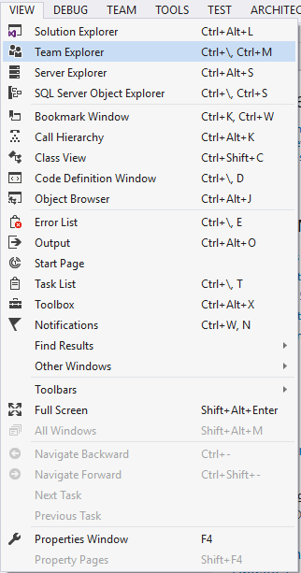
What didn’t work
Ctrl+\ didn’t open Team Explorer
ALT + HOME = didn’t open Home
Ctrl+M - worked sometimes
+→← Expand/collapse folder

Slide 17
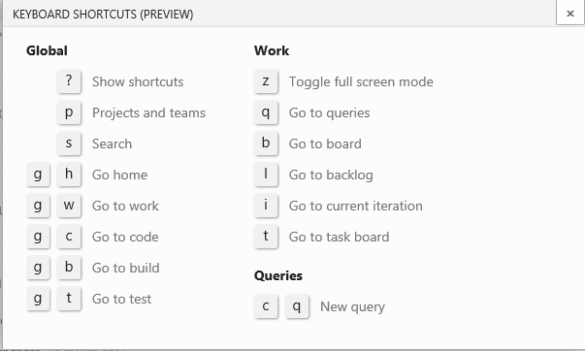
Resources
Wiki page: https://vsowiki.com/index.php?title=Keyboard_shortcut_manager
12/2 – mseng

